Slide 1
Volumetric Capture
Marcel Bruckner, Kevin Bein, Moiz Sajid

Slide 2
Goal
Reconstruct volumetric

Slide 3
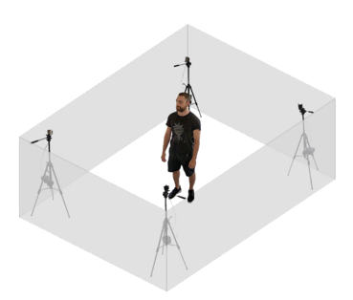
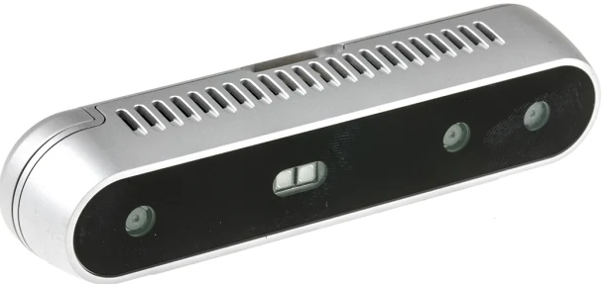
Setup
4x Intel RealSense Depth Camera D415
4x Tripods
USB Hub
USB Active Repeater Cables

Slide 4
Pipeline Overview
RGB and depth frame capture
Post-Processing
Align RGB and depth frame
ChArUco Board detection
Callibration via Procrustes, Bundle Adjustment and ICP
Fusion into Voxelgrid
Compute Marching Cubes

Slide 5
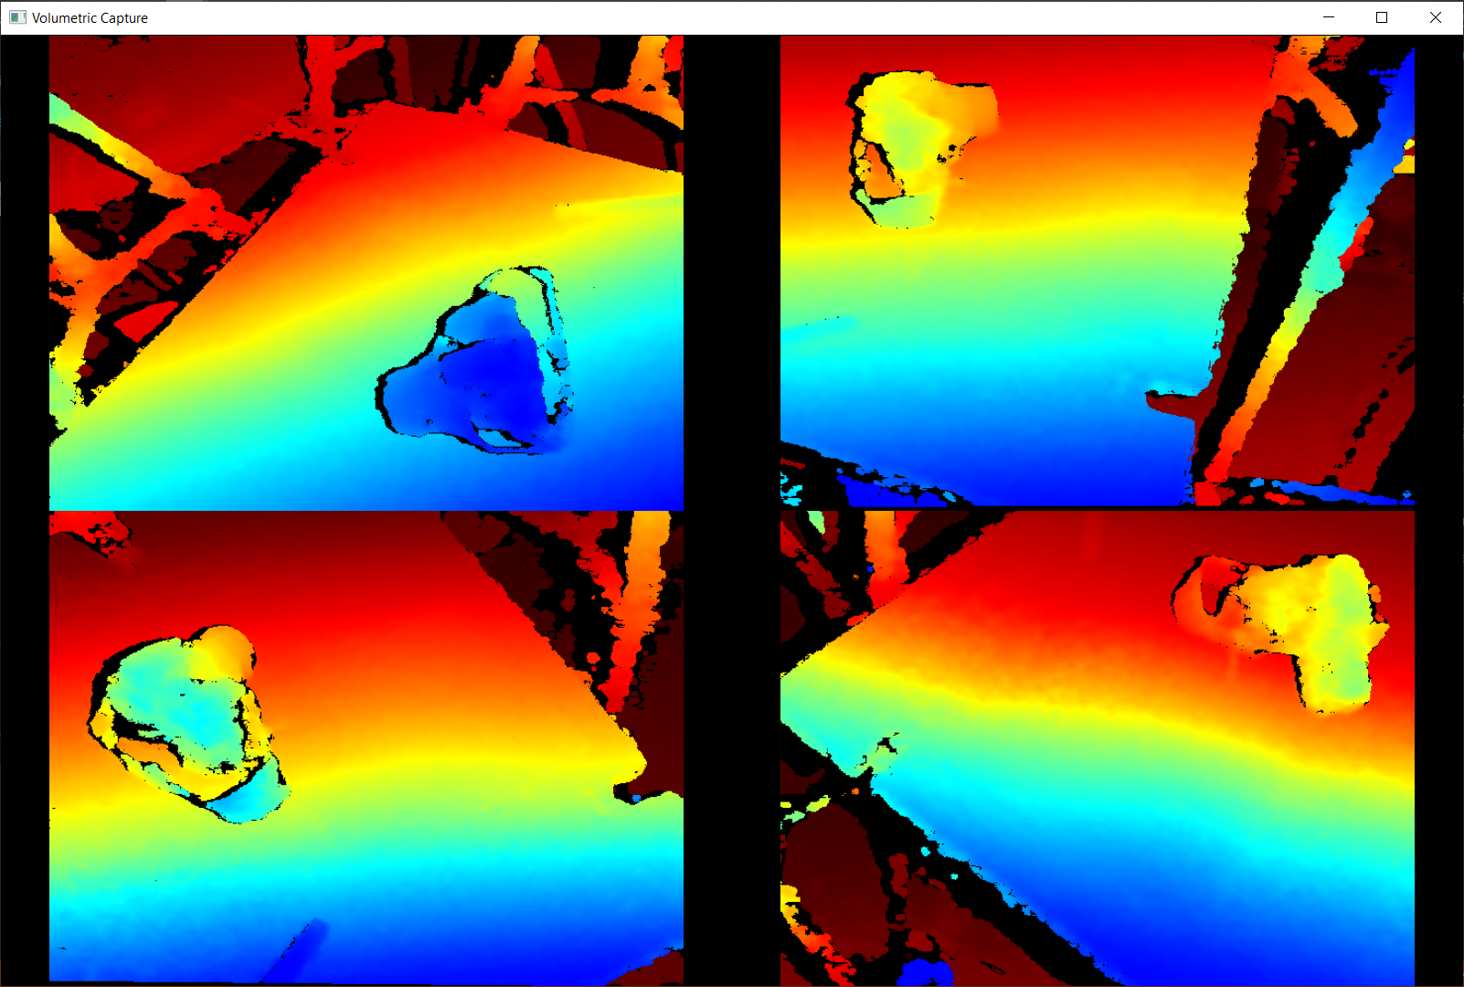
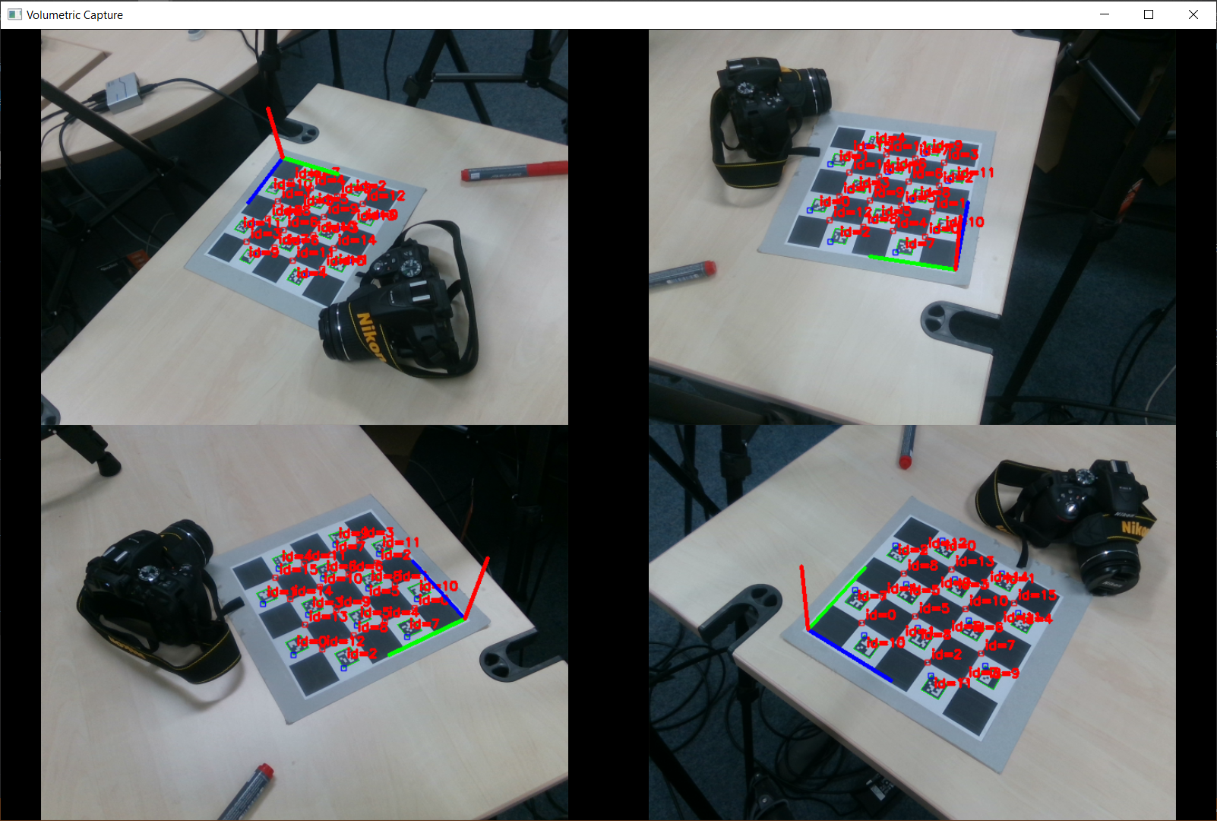
1. RGB and depth frame capture
1280x720 active stereo depth
1920x1080 RGB resolution

Slide 6
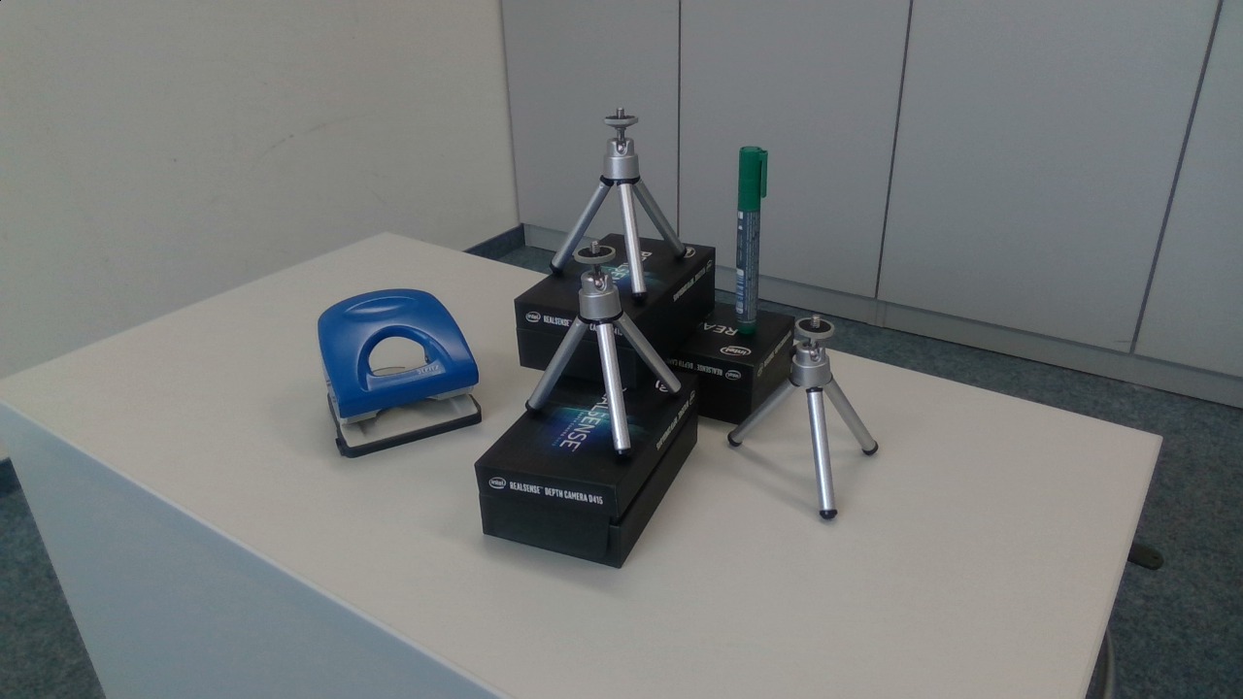
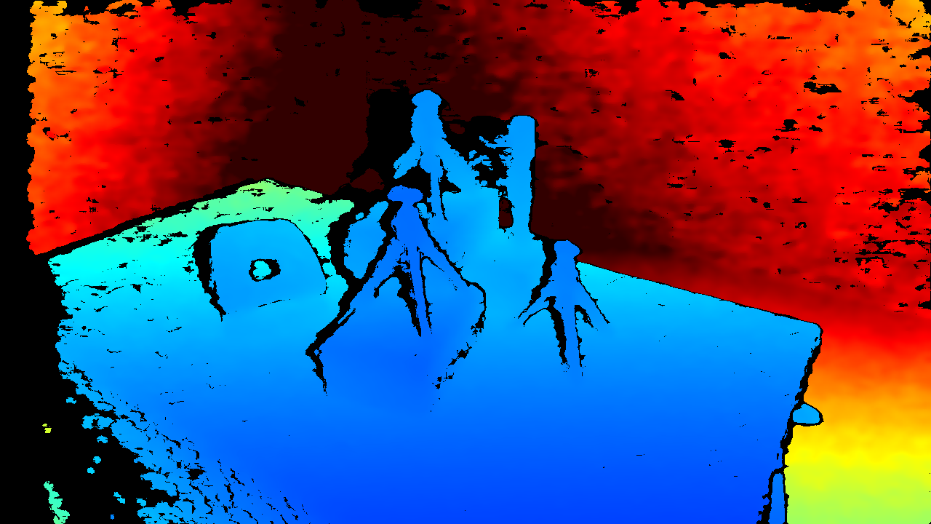
1. RGB and depth frame capture
1920x1080 RGB resolution
1280x720 active stereo depth

Slide 7
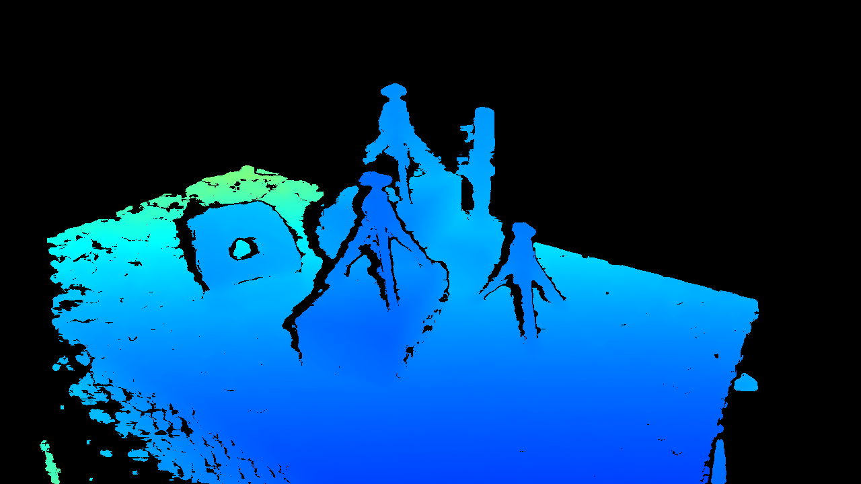
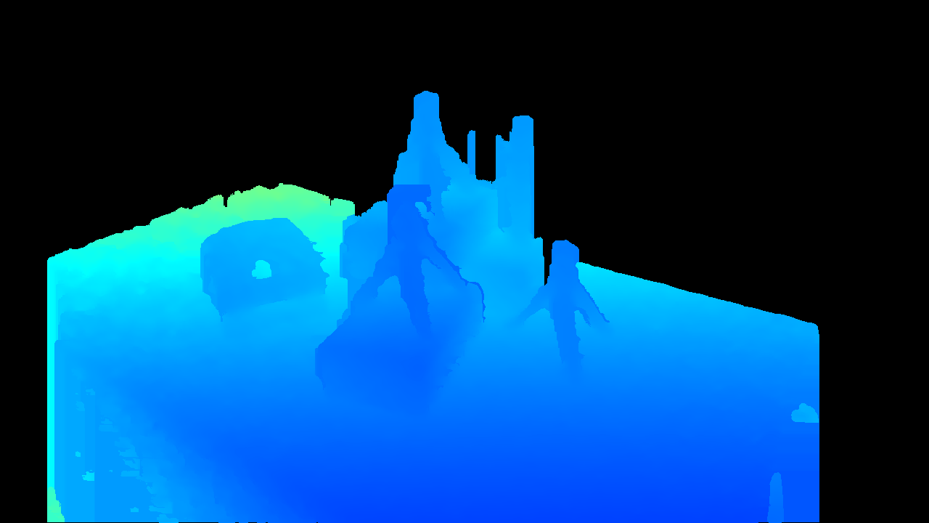
2. Post-Processing
2.1 Raw Input
2.2 Threshold Filter
2.3 Hole-Filling Filter

Slide 8
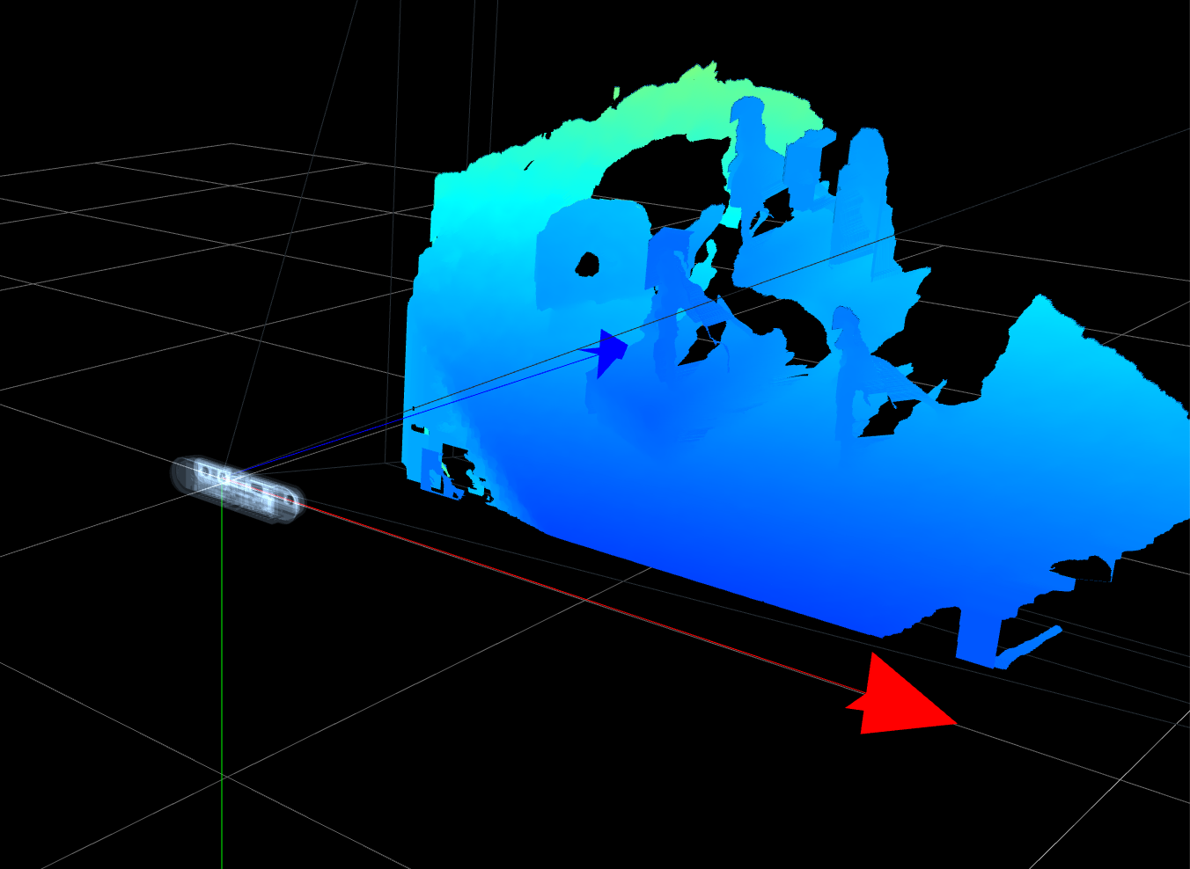
3. Align RGB and depth frame

Slide 9
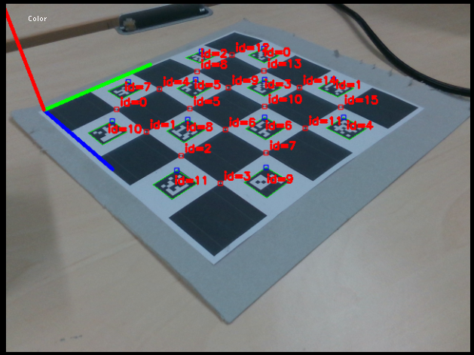
4. ChArUco Board detection
Detect 12 ChArUco corners in all camera streams

Slide 10
4. ChArUco Board detection
Detect 12 ChArUco corners in all camera streams

Slide 11
5. Callibration via Procrustes, Bundle Adjustment and ICP
Use detected ChArUco corners as correspondences
Initialize algorithm with Procrustes
Minimze error function
Run ICP for further refinement

Slide 12
6. Fusion into Voxelgrid
Calculate TSDF values
Fuse aligned points into Voxelgrid

Slide 13
7. Compute Marching Cubes

Slide 14
Implementation Details
Librealsense API
Camera communication
Post-processing filters: Hole-filling, Depth threshold
RGB and Depth alignment
OpenCV for ChArUco corner detection
OpenGL Rendering
OpenGL Shading Language
Immediate Mode GUI (imgui) for UX

Slide 15
Implementation Details
Custom implementation of Procrustes, Bundle Adjustment and ICP using Ceres solver
Custom implementation of Marching Cubes
Not used:
Point Cloud Library (PCL)
CUDA
DirectX

Slide 16
Live Demo

Slide 17
Volumetric Capture
Thank you! Questions?

